Slide 1
Query Processing & Optimization
By- Jesal Desai

Slide 2
Query processing -
Query processing refers to the range of activities involved in extracting data from a database.
The steps involved in processing a query are : -
1. Parsing and translation
2. Optimization
3. Evaluation

Slide 3
Before processing the query (which is the SQL query) , the system must translate the query into a usable form( language which system can understand). A more useful internal representation is based on the extended relational algebra.
SQL
Extended Relational algebra

Slide 4
Query processing and optimization
Parser and Translator
Relational Algebra expressions
Query
Optimizer
Evaluation engine
Execution plan
Query Output
Data
Statistics about data
Data

Slide 5


The parser checks the syntax of the user’s query, e.g verifies that the relation names appearing in the query are names of the relations in the database, and so on
Query Execution Plan - sequence of primitive operations used to evaluate a query
The query-execution engine takes a query-evaluation plan, executes that plan, and returns the answers to the query
$$πbalance$$
$σ$balance < 2500
account

Slide 6
Query optimization
The different evaluation plans created during query processing step for a given query can have different costs.
We do not expect users to write their queries in a way that suggests the most efficient evaluation plan.
Rather, it is the responsibility of the system to construct a query-evaluation plan that minimizes the cost of query evaluation. This is where query optimization comes into play
Once the query plan is chosen, the query is evaluated with that plan, and the result of the query is output.

Slide 7
Query optimization is the process of selecting the most efficient query-evaluation
plan from among the many strategies usually possible for processing a given query, especially if the query is complex

Slide 8
Consider the relational-algebra expression for the query :-
“Find the names of all customers who have an account at any branch located in Brooklyn.”
Πcustomer-name (σbranch−city =“Brooklyn” (branch X (account X depositor)))
This expression constructs a large intermediate relation, branch X account X depositor
whereas: -
Πcustomer-name ( (σbranch-city =“Brooklyn” (branch)) X (account X depositor))
which is equivalent to our original algebra expression, but which generates smaller intermediate relation

Slide 9
Πcustomer-name (σbranch−city =“Brooklyn” (branch X (account X depositor)))
Larger Intermediate Relation
whereas: -
Πcustomer-name ( (σbranch-city =“Brooklyn” (branch)) X (account X depositor))
which is equivalent to our original algebra expression, but which generates smaller intermediate relation
100
100
100
50
100
100

Slide 10
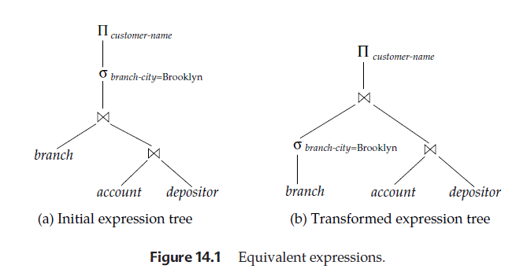

Slide 11
Generation of query-evaluation plans involves two steps:
(1) generating expressions that are logically equivalent to the given expression,
(2) estimating the cost of each evaluation plan.
To implement the first step, the query optimizer must generate expressions equivalent to a given expression. It does so by means of equivalence rules that specify how to transform an expression into a logically equivalent one

Slide 12
Equivalence Rules
An equivalence rule says that expressions of two forms are equivalent. We can replace an expression of the first form by an expression of the second form, or vice versa

Slide 13
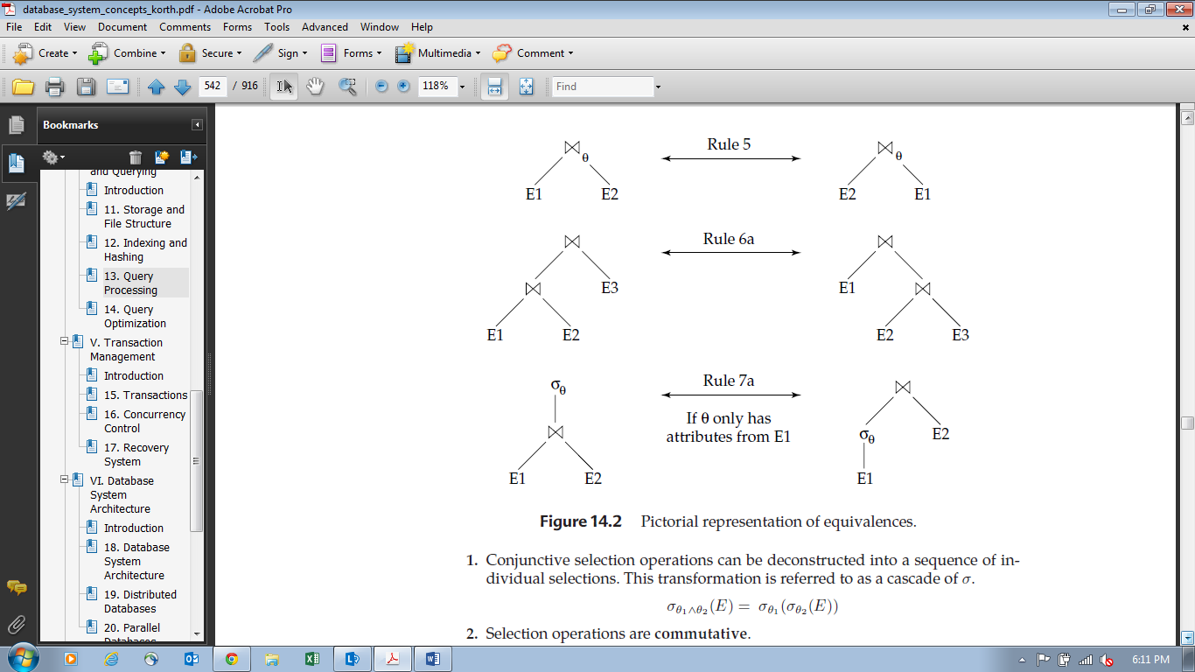

Slide 14
Examples of Transformations
We now illustrate the use of the equivalence rules. We use bank example with the relation schemas:
Example -1
Branch-schema = (branch-name, branch-city, assets)
Account-schema = (account-number, branch-name, balance)
Depositor-schema = (customer-name, account-number)

Slide 15
The relations branch, account, and depositor are instances of these schemas. The expression
Πcustomer-name(σbranch-city =“Brooklyn”(branch X (account X depositor)))
Πcustomer-name((σbranch-city =“Brooklyn”(branch)) X (account X depositor))
which is equivalent to our original algebra expression, but generates smaller intermediate relations.
Appling rule no.3

Slide 16
Suppose that we modify our original query to restrict attention to customers who have a balance over $1000.
The new relational-algebra query is :-
Πcustomer-name (σbranch-city =“Brooklyn” ∧ balance >1000 (branch X (account X depositor)))
branch X (account X depositor) (branch X account) X depositor:
Rule no 2

Slide 17
Πcustomer-name (σbranch-city =“Brooklyn” ∧ balance >1000 ((branch X account) X depositor))
Πcustomer-name ((σbranch-city =“Brooklyn”∧ balance>1000 (branch X account)) X depositor)
We can break the selection into two selections, to get the following subexpression:
σbranch-city =“Brooklyn” (branch) X σbalance>1000 (account)
Both of the preceding expressions select tuples with branch-city = “Brooklyn” and balance > 1000. However, the latter form of the expression provides a new opportunity to apply the “perform selections early” rule.
100
100
100
Using rule no 3
20
200
X 100
10
10

Slide 18
Intermediate result
Πcustomer-name ((branch-city =“Brooklyn” (branch)) X (σbalance>1000 (account)) x depositor)
x 100
10
10

Slide 19
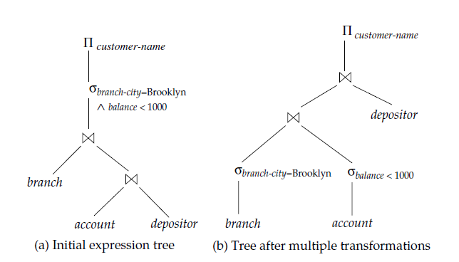
Figure below depicts the initial expression and the final expression after all these transformations

